Slide 1

COVID 19 DETECTION
By:
Name : M.Snowlin Jeha
Degree :B.E
Branch :CSE
College :PET Engineering College
NM Id :aut21012067
Email id : snowlinjeha283@gmail.com

Slide 2
OUTLINE
Problem Statement
Proposed System/Solution
System Development Approach
Algorithm and Deployment
Result
Conclusion
References

Slide 3
PROBLEM STATEMENT
Problem Statement : A correlation study to access the knowledge and self-expressed stigma regarding COVID-19 Outbreak among adults at selected society of Pune city.
Methodology : COVID-19 prevalence estimated by random sampling in population optimal sample pooling under varying assumptions about true prevalence. The number of confirmed COVID-19 cases divided by population size is used as a coarse measurement for the burden of diseases in a population.
Objectives :
To access the knowledge regrading COVID-19 Outbreak among adults. Study to access self-expressed stigma regrading COVID-19 Outbreak among.
To access the correlation between knowledge and self-expressed stigma regarding COVID-19 Outbreak among adults.
To associate the major findings of knowledge regarding COVID-19 Outbreak with selected demographic.
To associate the major findings of self-expressed stigma regarding COVID-19 Outbreak with selected demographic.

Slide 4
PROPOOSED SYSTEM AND SOLUTION
RT-PCR Testing : This is the gold standard for Covid-19 detection, detecting the genetic material of the virus. However, it requires specialized equipment and trained personnel, making it has accessible in some areas.
Rapid Antigen Testing : These tests detect specific protein on the surface of the virus and provide results within minutes. They are less accurate than RT-PCR but are faster and more widely available.
Serological Tests : These tests detect antibodies produced by the body in response to the virus. They are useful for determining past infection by may not be reliable for diagnosing current infection.
AI-Based Solutions : Machine learning algorithms have been used to analyze medical images such as chest X-rays and CT scans to detect patterns indicative of COVID-19 infection. These systems cam aid in diagnosis especially in resource-limited settings.
Smartphone Apps : There are apps that use symptom tracking and contact tracing tracking to help identify potential Covid-19 cases and slow the spread of the virus. Some apps also provide information on testing locations and quarantine guidelines.

Slide 5
SYSTEM APPROACH
PCR Testing : Polymerase Chain Reaction (PCR) tests detect the genetic material of the virus. It’s considered the gold standard for diagnosis due to its high accuracy.
Rapid Antigen Tests : These detect specific proteins on the surface of the virus. They provide quicker results compared to PCR tests but many be less sensitive.
Antibody Tests : These detect produced by the immune system in response to the virus. They indicate past infection rather than current infection.
CRISPR-Based Tests : CRISPR technology has been adapted for COVID-19 detection, offering potential for rapid and sensitive testing.
Machine Learning Algorithms : Machine learning algorithms can analyze medical imaging (like X-rays or CT scans) or patient data to assist in COVID-19 detection and diagnosis.
Symptom Tracking Apps : Mobile applications can track symptoms and exposure to identify potential cases and aid contact tracking efforts.
Each approach has its advantages and limitations and a combination of these methods is often used for effective COVID-19 detection and management.

Slide 6
ALGORITHM AND DEPLOYMENT
Data Collection : Gather a dataset of medical images (such as X-rays or CT scans) labeled with COVID-19 positive and negative cases.
Preprocessing : Clean and preprocess the images to enhance features and remove noise.
Feature Extraction : Extract relevant features from the images using techniques like deep learning or traditional image processing algorithms.
Model Training : Train a machine learning or deep learning model using the labeled dataset. Common algorithms include convolutional neural networks (CNNs).
Validation and Testing : Validate the model’s performance using a separate dataset and fine-tune it if necessary. Test the model on unseen data to evaluate its accuracy, sensitivity, and specificity.
Deployment : Deploy the trained model as a web application, mobile app, or integrate it into existing healthcare systems. Ensure compliance with regulations and standards for medical software.
Continuous Improvement : Continuously update and improve the algorithm as more data becomes available and new techniques emerge.
Deployment involves considerations such as scalability, security, and accessibility to ensure the algorithm can be effectively used by healthcare professionals for COVID-19 detection.

Slide 7
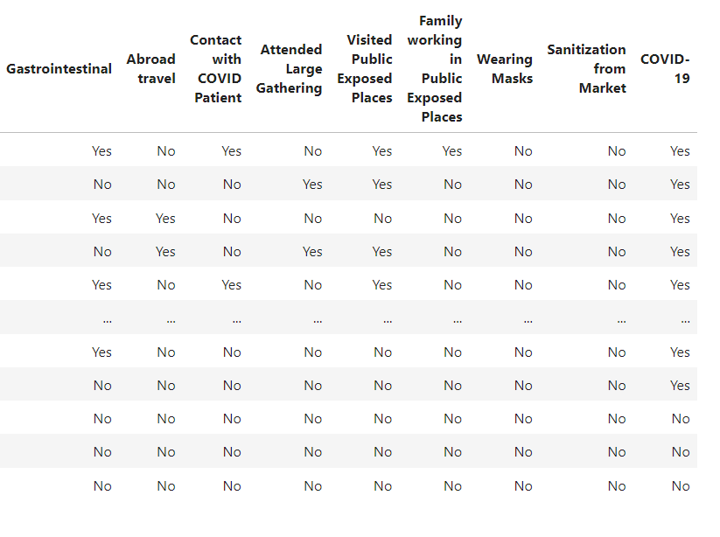
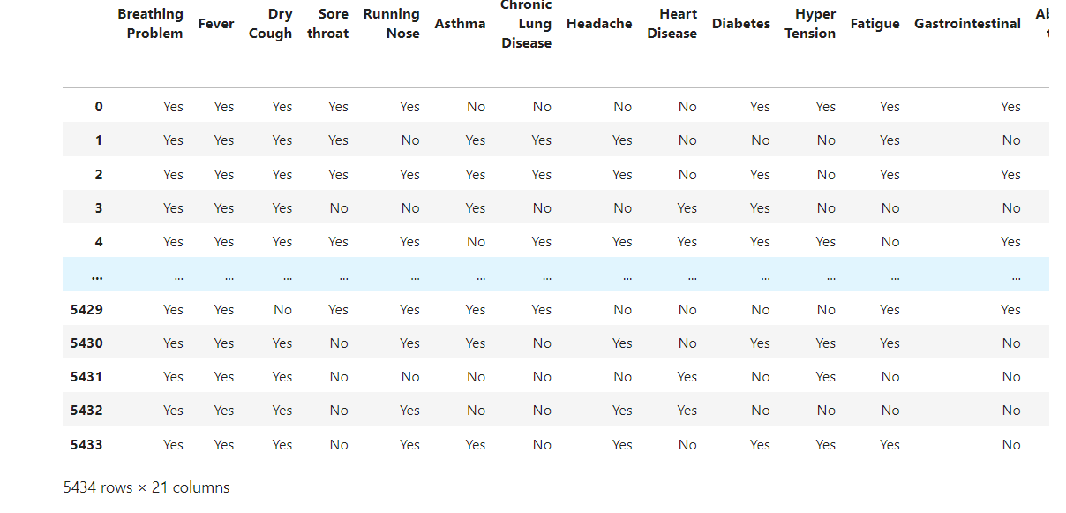
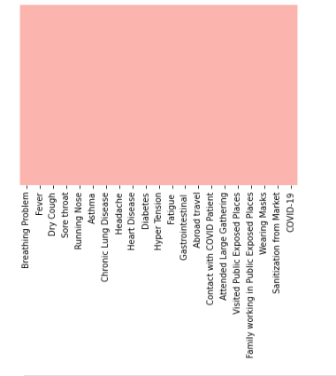
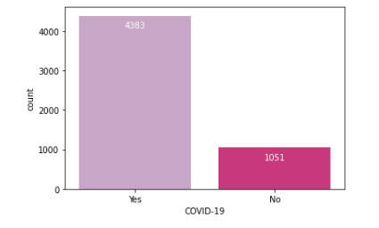
Result

Slide 8
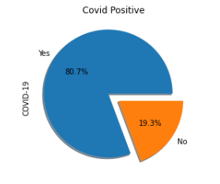
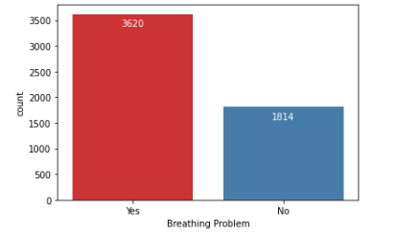
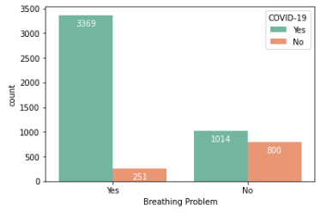
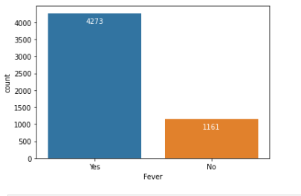
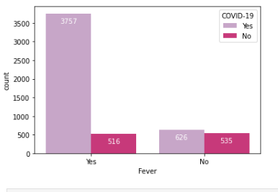

Slide 9
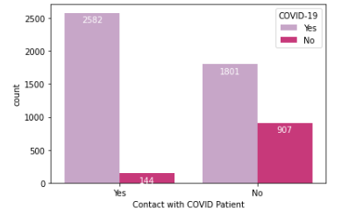
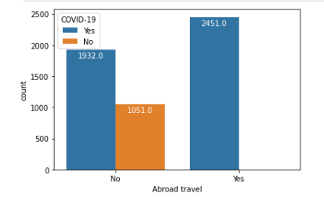
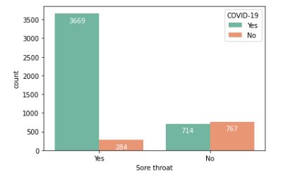
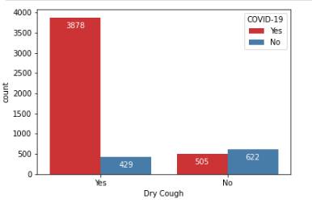

Slide 10
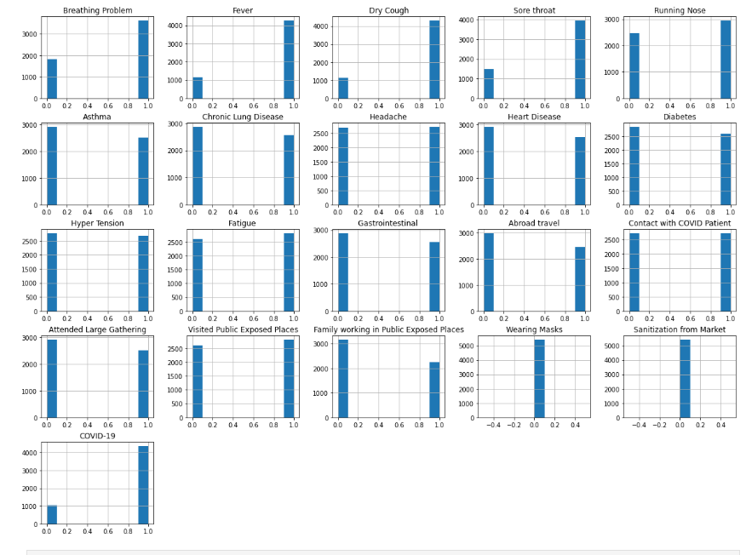

Slide 11
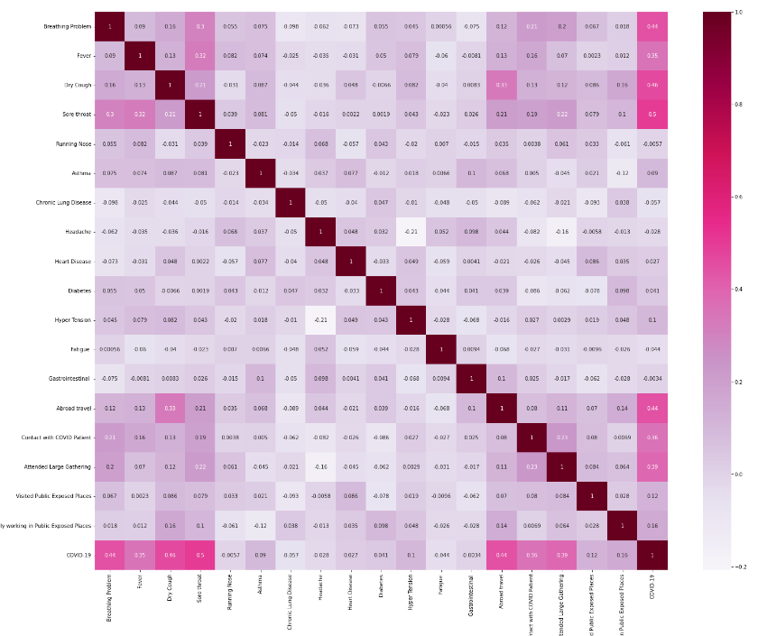
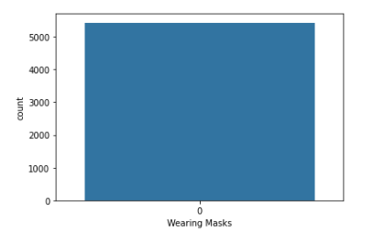
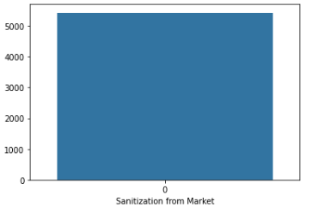

Slide 12
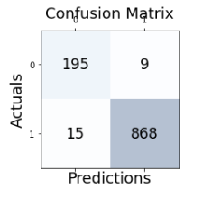
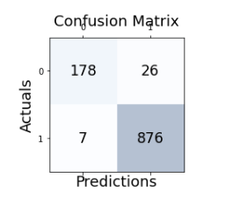
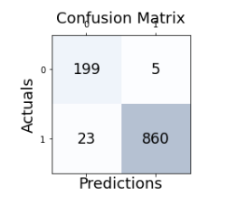
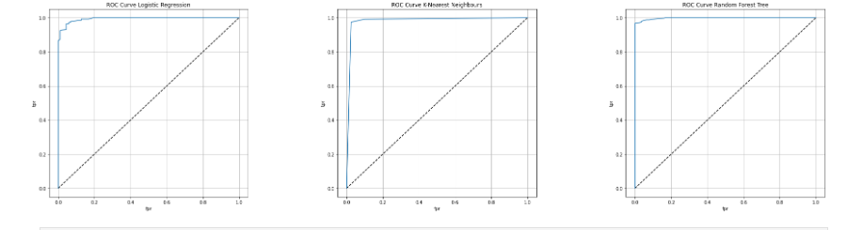

Slide 13
CONCLUSION
As of my last update in January 2022, COVID-19 detection primarily relies on PCR testing, antigen tests, and antibody tests. PGR tests are the most accurate for detecting active infections, while antigen tests provide rapid results. Antibody tests indicate past infection or vaccine response. It’s crucial to consult healthcare professionals for accurate diagnosis and interpretation of test results. Additionally, advancements in technology and research may have led to improvements or change in detection methods since then.

Slide 14
REFERENCE
Coronavirus disease 2019-World Health Organization 2019. https://www.who.int
Detail Question and Answers on Covid-19 for Public Ministry of Health and Family welfare. https://www.mohfw.gov.in
Coronavirus Update. https://www.worldometers.info > coronavirus
Social Stigma Forcing Coronavirus Patients. https://www.medicalbuyer.co.in
Symptoms of coronavirus. https://www.cdc.gov > 2019-ncov

